Slide 1
tiradointeractive.com
Create User
Login
Banking
Media Player
Clients
Code Library
Accounts
Transactions
Playlists
Timesheets
Code Library
Folders
Email Code
Forgot Password
Email
Invoices
Email

Slide 2
t
tiradoonline.com

Slide 3
t
LOGIN
`
X
t
tiradointeractive.com
ERROR MESSAGE
Username:
Password:
login
Not a user?
Create Account
Forgot
Password?

Slide 4
`
CREATE ACCOUNT
X
t
t
ERROR MESSAGE
Username:
tiradointeractive Intranet
Password:
Confirm Password:
First Name:
Last Name:
Email:
Cell Phone:
Cell Phone Provider:
create account

Slide 5
t
FORGOT PASSWORD
`
X
t
tiradointeractive.com
Enter your email address.
Email:
email

Slide 6
t
tiradointeractive.com
Menu
Banking | Media Player | Snippets | Timesheets | Welcome teddy
Menu submenu
Banking | Media Player | Snippets | Timesheets | Welcome teddy
Accounts
Bill Reminders
Reports
<New Account>
<Search>
Checking | $1009.95
Best Buy | 845.00
Dunkin Donuts | 14.55
Chase | -2.38
Teddy | -300.25
<New Transaction>

Slide 7
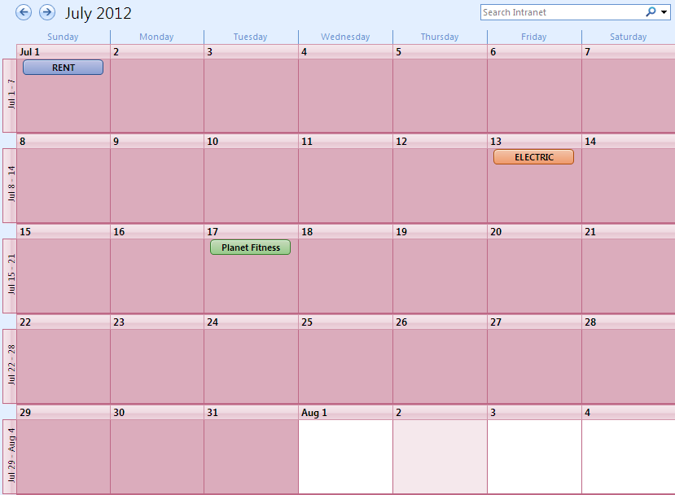
t
tiradointeractive.com
Banking | Media Player | Snippets | Timesheets | Email | Welcome teddy
Bill reminders

Slide 8
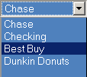


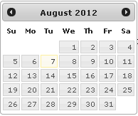
t
tiradointeractive.com
Banking | Media Player | Snippets | Timesheets | Welcome teddy
Bill reminders
`
CREATE REMINDER
X
t
ERROR MESSAGE
ACCOUNT:
Date:
2sds
Account:
Category:
Transaction:
+
Amount:
Memo:
create transaction

Slide 9
t
tiradointeractive.com
Menu
Banking | Media Player | Snippets | Timesheets | Welcome teddy
Menu hover
CREATE ACCOUNT
`
X
Banking | Media Player | Snippets | Timesheets | Welcome teddy
t
ERROR MESSAGE
Menu submenu
Account:
Banking | Media Player | Snippets | Timesheets | Welcome teddy
Accounts
Reports
Color Code:
Menu submenu hover
create
Banking | Media Player | Snippets | Timesheets | Welcome teddy
Accounts
Reports
<New Account>
Checking | $1009.95
Best Buy | 845.00
Dunkin Donuts | 14.55
Chase | -2.38
Teddy | -300.25

Slide 10
t
tiradointeractive.com
Banking | Media Player | Snippets | Timesheets | Welcome teddy
Banking - Accounts
Checking
$1009.95
Best Buy
845.00
Dunkin Donuts
14.55
<Edit>
<New Transaction>
Teddy
$-300.25

Slide 11
t
tiradointeractive.com
Banking | Media Player | Snippets | Timesheets | Welcome teddy
Banking - REPORTS
September 2012
ACCOUNT:
November 2012
CHECKING

Slide 12
t
tiradointeractive.com
Banking | Media Player | Snippets | Timesheets | Welcome teddy
Banking
20
Date | Category | Transaction | Amount | Balance
Previous Balance: |  |  |  | -2,512.64
3/17/12 | Checking | Rent | -800 | -3312.64
 |  | Check# 1001
3/17/12 |  | Blockbuster Online | -18.50 | -3331.14
 |  | Monthly Bill
3/19/12 | Chase | Planet Fitness | -19.99 | -3351.13
 |  | Monthly Bill
3/20/12 |  | Hostway | -5.95 | -3357.08
 |  | Monthly Bill
3/21/12 | Checking | Deposit | 200 | -3157.08
 |  | Direct Deposit
3/24/12 |  | Withdrawl | -100 | -3257.08
Balance: |  |  |  | -3257.08
September 2012
ACCOUNT:
November 2012

Slide 13
t
tiradointeractive.com
Banking | Media Player | Snippets | Timesheets | Welcome teddy
Banking
`
CREATE TRANSACTION
X
t
ERROR MESSAGE
Date | Category | Transaction | Amount | Balance
Previous Balance: |  |  |  | -2,512.64
3/17/12 | Checking | Rent | -800 | -3312.64
 |  | Check# 1001
3/17/12 |  | Blockbuster Online | -18.50 | -3331.14
 |  | Monthly Bill
3/19/12 | Chase | Planet Fitness | -19.99 | -3351.13
 |  | Monthly Bill
3/17/12 |  | Hostway | -5.95 | -3357.08
 |  | Monthly Bill
3/17/12 | Checking | Deposit | 200 | -3157.08
 |  | Direct Deposit
3/17/12 |  | Withdrawl | -100 | -3257.08
Balance: |  |  |  | -3257.08
September
ACCOUNT:
Date:
November
2sds
Account:
Category:
Transaction:
+
Amount:
Memo:
create transaction

Slide 14
t
tiradointeractive.com
Banking | Media Player | Snippets | Timesheets | Welcome teddy
Banking
`
SEARCH TRANSACTION
X
t
ERROR MESSAGE
Date | Category | Transaction | Amount | Balance
Previous Balance: |  |  |  | -2,512.64
3/17/12 | Checking | Rent | -800 | -3312.64
 |  | Check# 1001
3/17/12 |  | Blockbuster Online | -18.50 | -3331.14
 |  | Monthly Bill
3/19/12 | Chase | Planet Fitness | -19.99 | -3351.13
 |  | Monthly Bill
3/17/12 |  | Hostway | -5.95 | -3357.08
 |  | Monthly Bill
3/17/12 | Checking | Deposit | 200 | -3157.08
 |  | Direct Deposit
3/17/12 |  | Withdrawl | -100 | -3257.08
Balance: |  |  |  | -3257.08
September
ACCOUNT:
Start Date:
November
2sds
End Date:
2sds
Account:
Transaction:
+
Amount:
Memo:
search

Slide 15
t
tiradointeractive.com
Banking | Media Player | Snippets | Timesheets | Welcome teddy
Banking
`
CREATE TRANSACTION
X
t
CREATE TRANSACTION TYPE
ERROR MESSAGE
`
X
Date | Category | Transaction | Amount | Balance
Previous Balance: |  |  |  | -2,512.64
3/17/12 | Checking | Rent | -800 | -3312.64
 |  | Check# 1001
3/17/12 |  | Blockbuster Online | -18.50 | -3331.14
 |  | Monthly Bill
3/19/12 | Chase | Planet Fitness | -19.99 | -3351.13
 |  | Monthly Bill
3/17/12 |  | Hostway | -5.95 | -3357.08
 |  | Monthly Bill
3/17/12 | Checking | Deposit | 200 | -3157.08
 |  | Direct Deposit
3/17/12 |  | Withdrawl | -100 | -3257.08
Balance: |  |  |  | -3257.08
September
ACCOUNT:
Date:
November
t
ERROR MESSAGE
Account:
Transaction:
+
Category:
Transaction:
+
Amount:
create
Memo:
create transaction

Slide 16
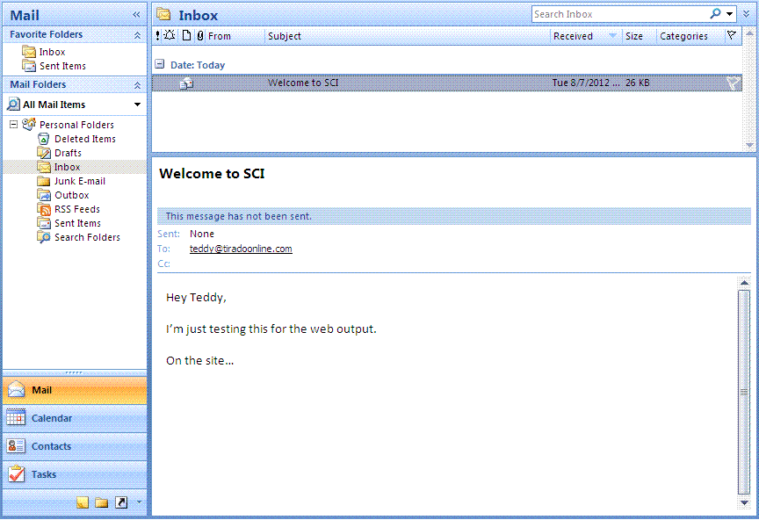
t
tiradointeractive.com
Banking | Media Player | Snippets | Timesheets | Welcome teddy
Email

Slide 17
USER CONTROLS
PLUS/MINUS text box for amount
RED FOR NEGATIVE
GREEN FOR POSITIVE
ONLY NUMBERS, COMMAS AND PERIODS CAN BE ENTERED
BANKING GRID
CAN BE RE-USABLE FOR BANKING TRANSACTIONS PAGE AND FOR HTML BASED DAILY EMAILS

